Slide 1


CREDIT CARD ANALYSIS IN BETWEEN DIFFERENT CATEGORIES OF PEOPLES
NAME- HIMANK KULSHRESHTHA BATCH – DS 21AUG03

Slide 2

SUMMARY -
Analysis is done in between different segments of people as – Entrepreneur , Other Salaried & Self Employed.
Data is downloaded from Kaggle .
In the data there is 325 Rows & 10 Columns .
DATA CLASSIFICATION –
Count of Females is 150
Count of Males is 174

Slide 4
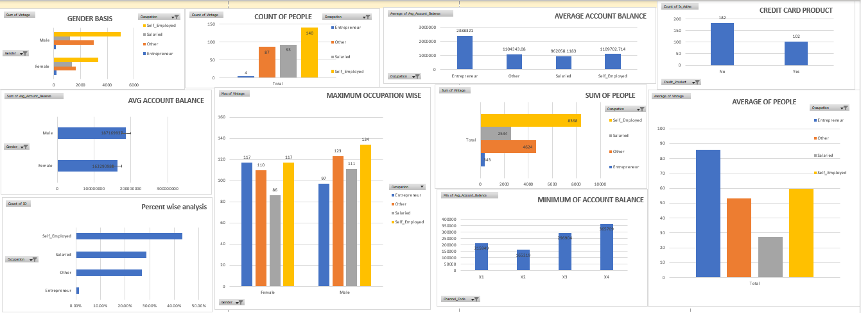
ANALYSIS OF CREDIT CARD USES IN BETWEEN DIFFERENT SECTOR OF PEOPLE

Slide 5
CONCLUSION -
On the Basis of Gender found that Males has better usage than Females.
On the Basis of Average Account Balance , Males have more average account balance than Females .
Self Employed peoples uses more credit card than others as comparison with Salaried and along with Entrepreneurs.
On the Basis of Percentage wise Analysis found that , Self Employed peoples have more percentage of usage than other , Salaried , Self Employed & Entrepreneurs.
On the Basis of Occupation Wise usage , Entrepreneur Females has maximum uses than other females in Salaried , Self Employed & Other categories .
On the Basis of Occupation wise usage , Self Employed Men , have more usage than comparison in the Other , Salaried & Entrepreneurs categories.
On the basis of Average people usage , Entrepreneurs uses more than as comparison in between other categories .

Slide 6
VIDEO SLIDE PPT LINK -
http://sc.com.ly/show/JEI5nNQMUcy3G4LHOgK0ebAjxdshXPBf
http://sc.com.ly/show/JEI5nNQMUcy3G4LHOgK0ebAjxdshXPBf

